Slide 1
OpenModelica Eclipse Setup
Adrian.Pop@liu.se
2013-10-09

Slide 2
Important notices
Make sure you use paths with no spaces
  For Eclipse workspace
  For OpenModelica project
Make sure your Eclipse is not running until
the slide which tells you to start Eclipse
If you want omc to include the revision number in the omc version install TortoiseSVN command line svn client and put it in your path

Slide 3
Checkout OMDev into C:\OMDev
OMDev url:
https://openmodelica.org/svn/OpenModelica/installers/windows/OMDev
Add OMDEV environment variable pointing to C:\OMDev
JDK 32bit needs to be installed and Msys should be able to find it! Put it in your PATH environment variable.

Slide 4
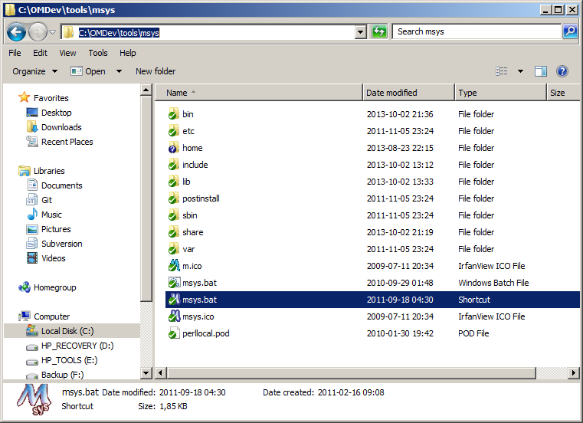
Msys location – use the shortcut

Slide 5
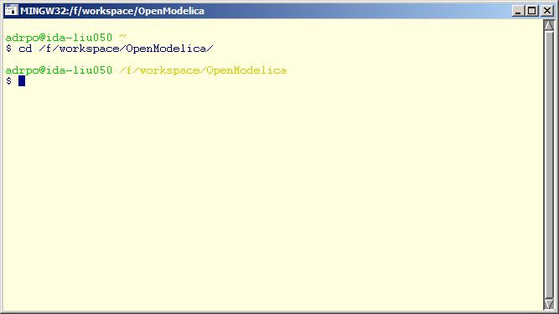
Msys – a Linux like terminal
We will use this one later

Slide 6
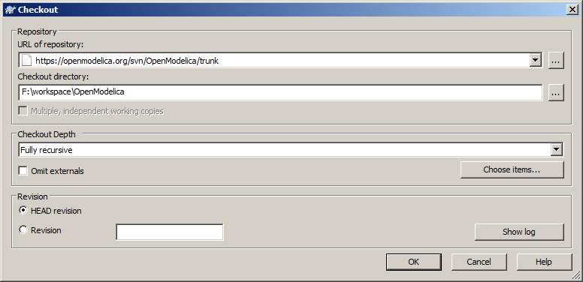
Checkout OpenModelica

Slide 7
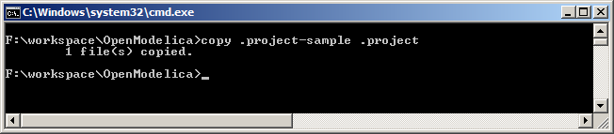
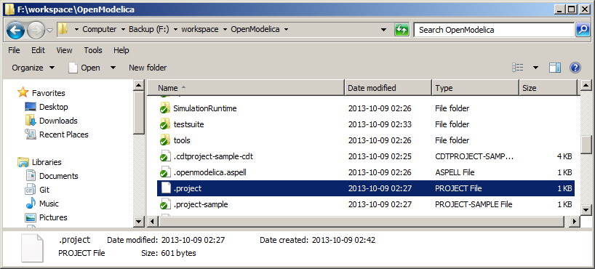
Copy .project-sample to .project

Slide 8
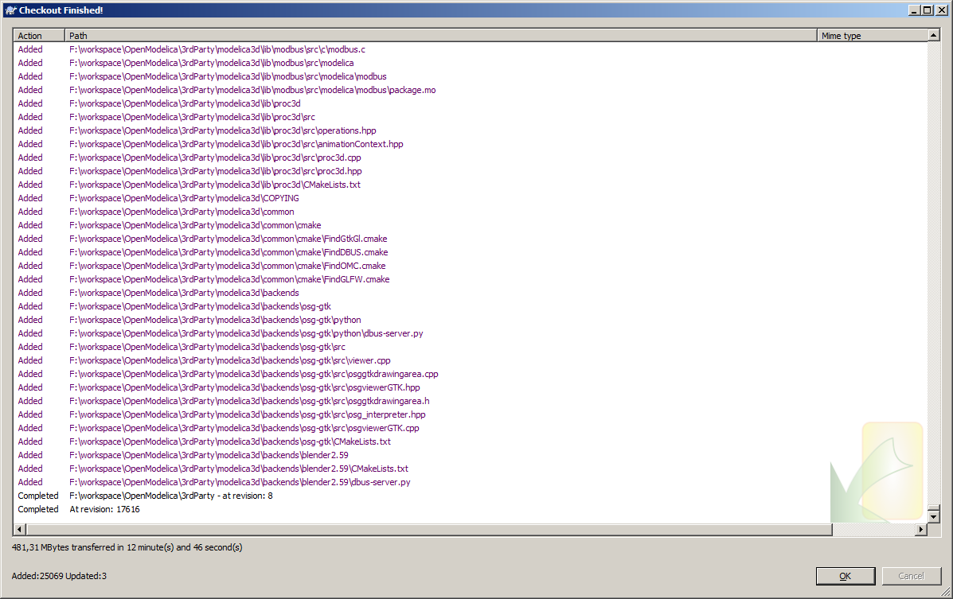
Checkout OpenModelica - done

Slide 9
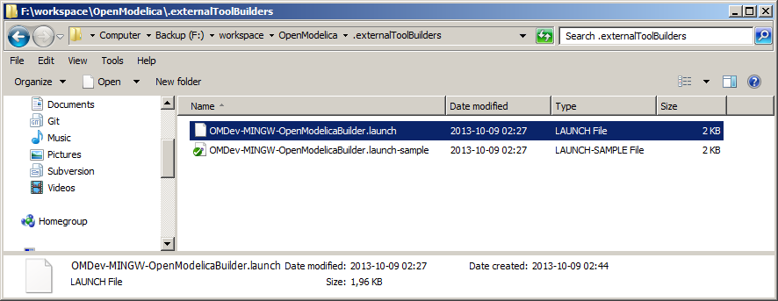
Copy OMDev-MINGW-OpenModelicaBuilder.launch-sample to
OMDev-MINGW-OpenModelicaBuilder.launch in workspace\OpenModelica\.externalToolBuilders

Slide 10
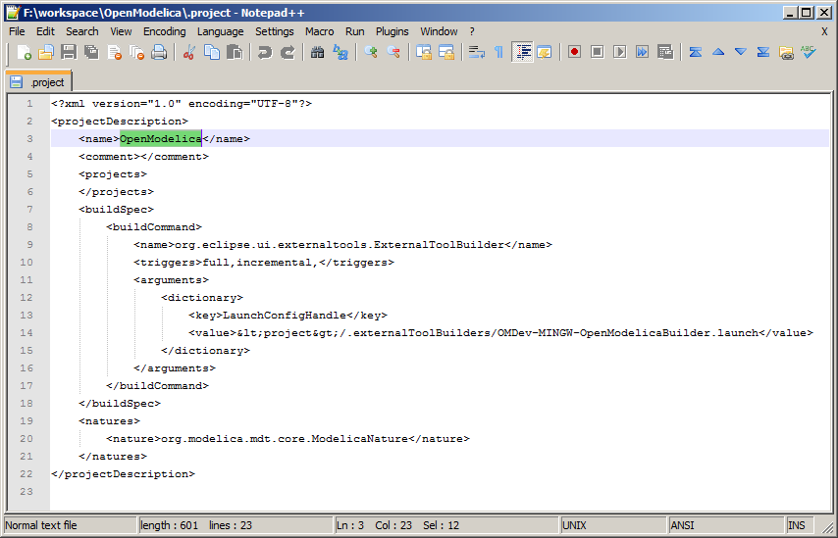
If your project is not named OpenModelica change it in .project

Slide 11
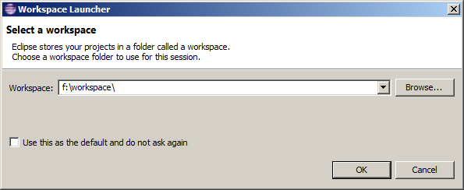
Start Eclipse
Install MDT in Eclipse if you haven’t done that yet:
https://trac.openmodelica.org/documents/MDT/install/

Slide 12
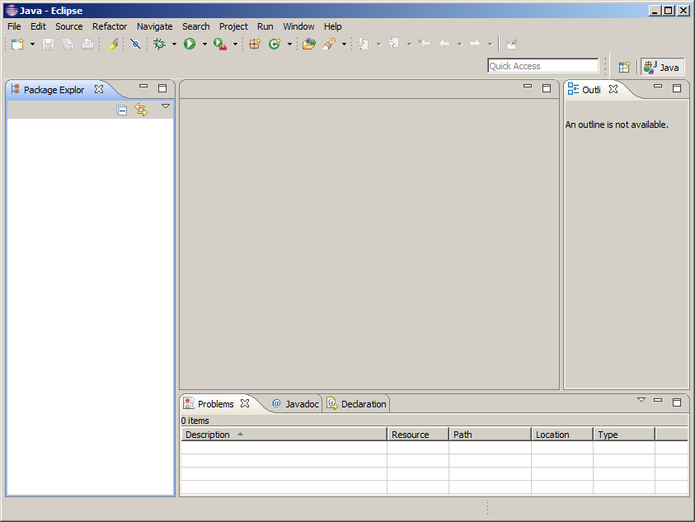
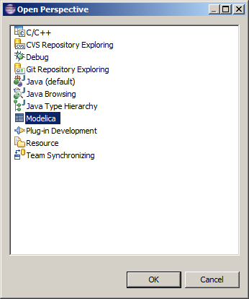
Switch to Modelica perspective

Slide 13
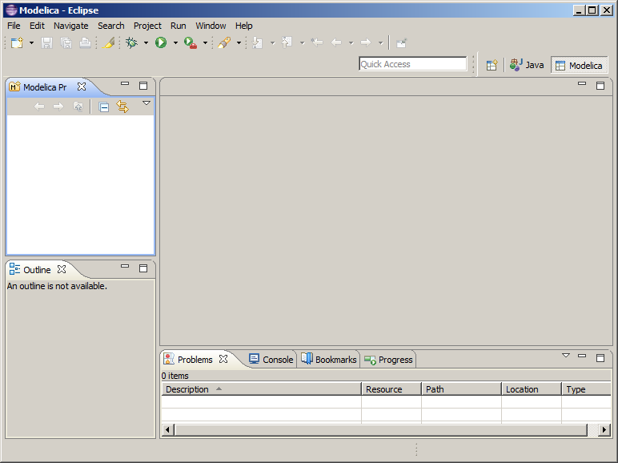
Modelica perspective

Slide 14
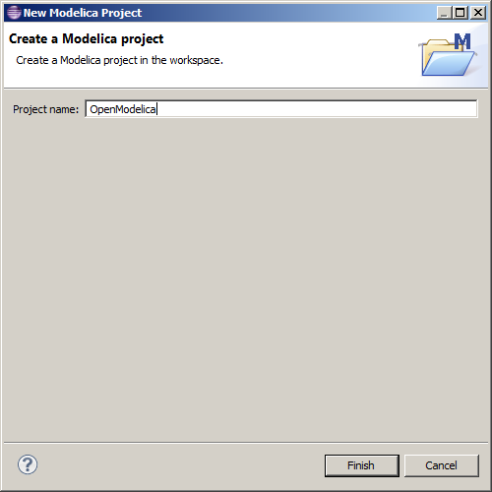
New Modelica project named OpenModelica
(or the name you chose)

Slide 15
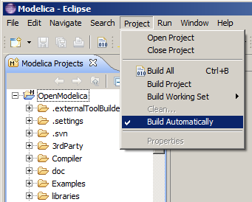
Remove Build automatically from Project

Slide 16
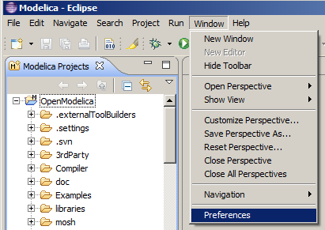
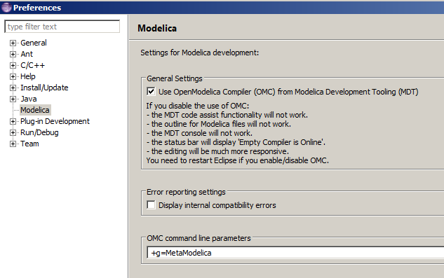
Add +g=MetaModelica to omc flags
RESTART ECLIPSE
AFTER THIS CHANGE

Slide 17
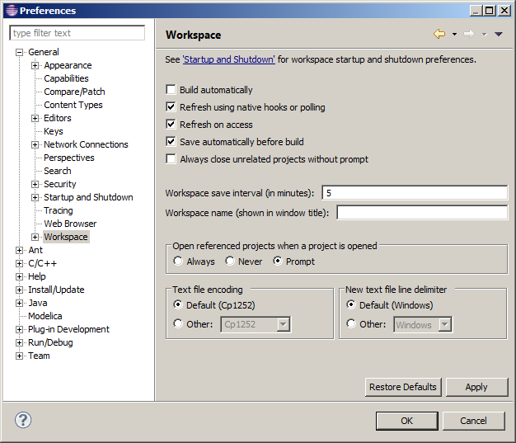
Important notice
In Eclipse is best to do refresh on a workspace automatically, via
Window->
Preferences

Slide 18
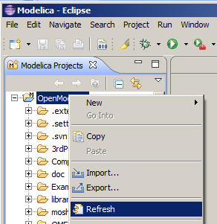
Refresh project, right click->Refresh

Slide 19
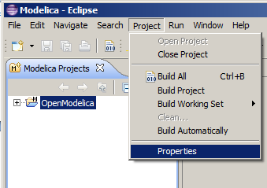
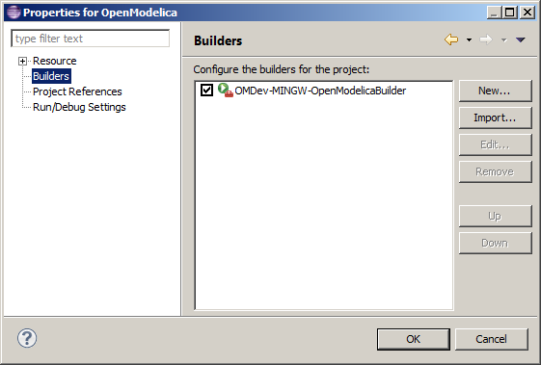
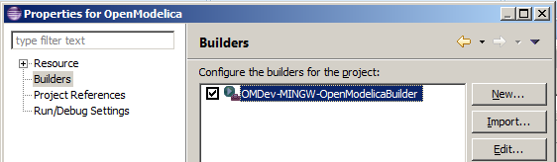
Check settings in Project builder

Slide 20
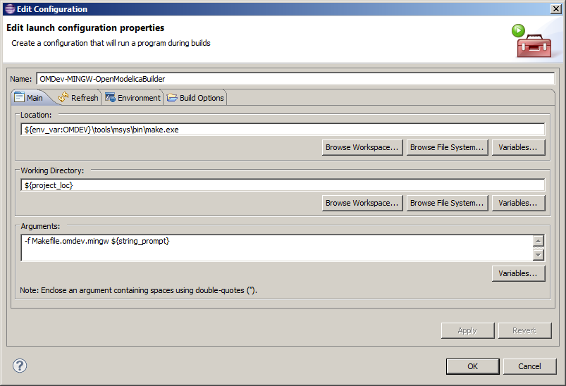
Check settings in all tabs!

Slide 21
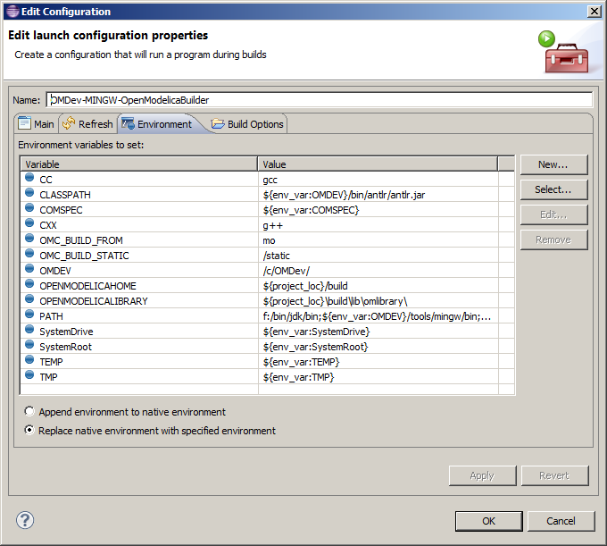
Check settings in all tabs!
Make sure jdk 32 bit
is in your PATH

Slide 22
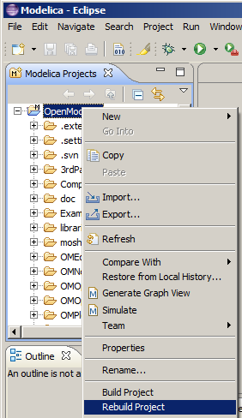
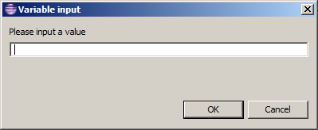
Build Project
Leave empty and
click OK to build omc
…….
It does take a while.
Check the builder settings
if there are errors

Slide 23
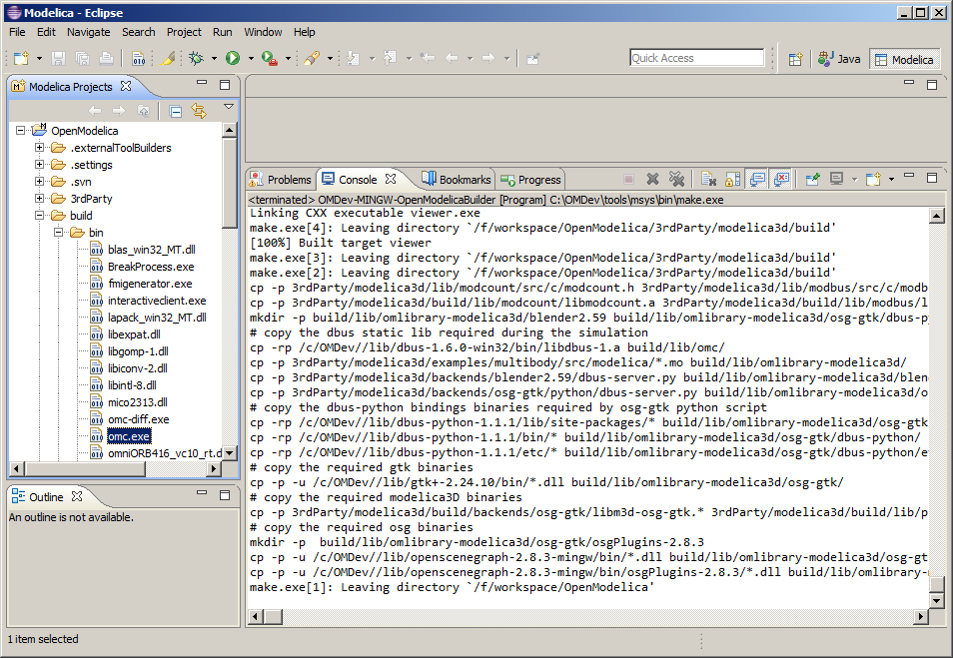
OpenModelica project was build
Refresh project
and check build/bin/

Slide 24
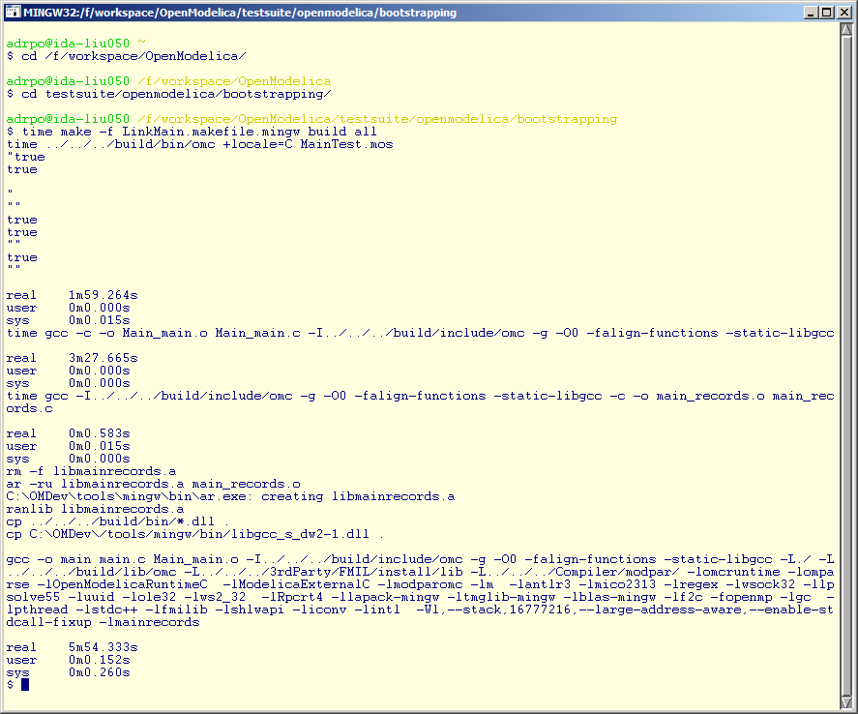
Build the bootstrapped compiler
Use
Msys

Slide 25
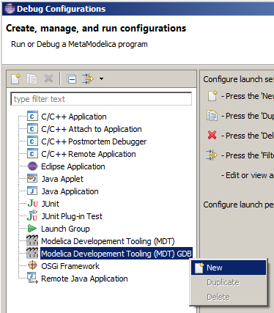
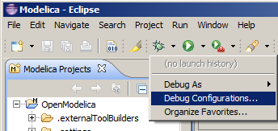
Setup Eclipse Debugging
Refresh project and check
testsuite/openmodelica/bootstrapping

Slide 26
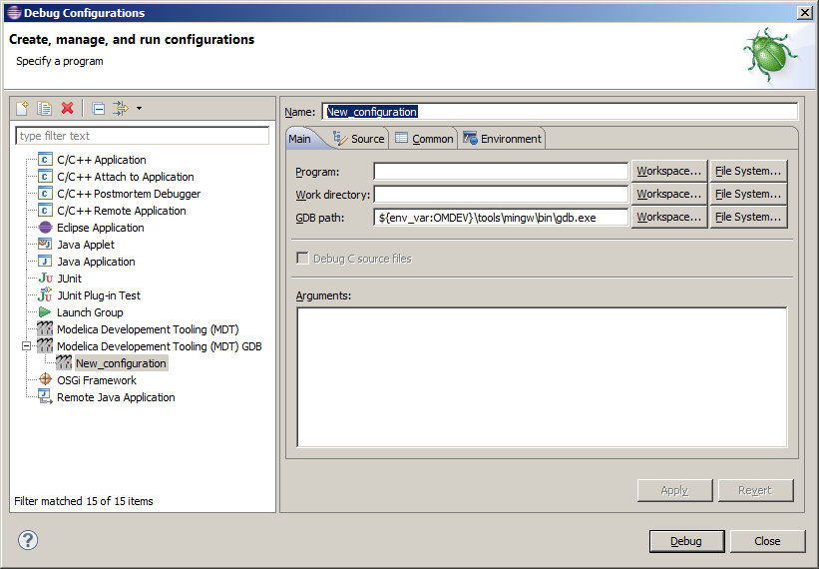
Change name

Slide 27
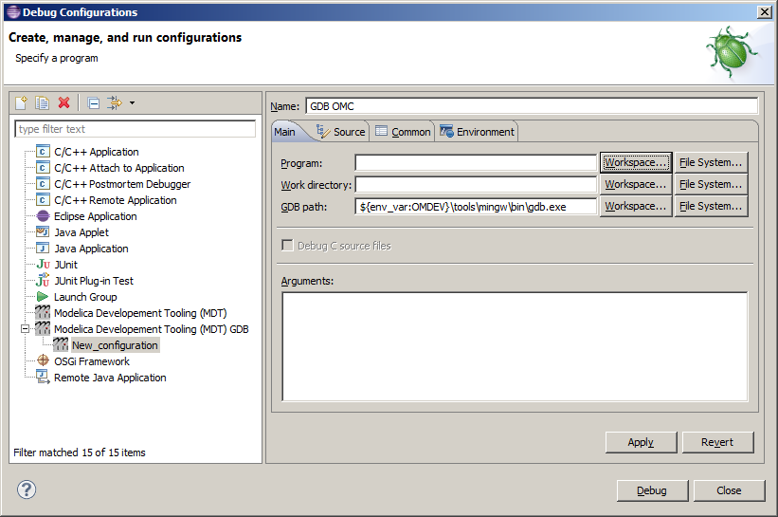
Select program

Slide 28
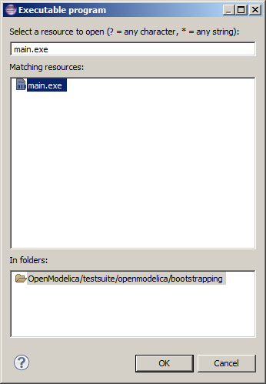
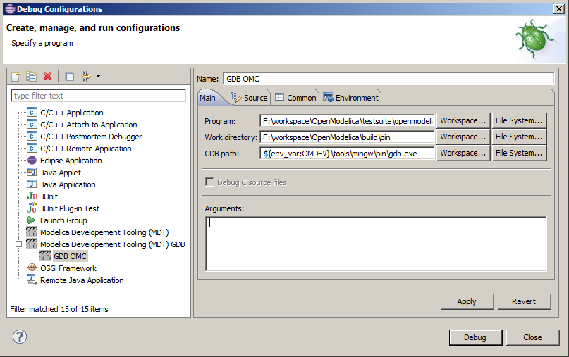
Select program and work directory

Slide 29
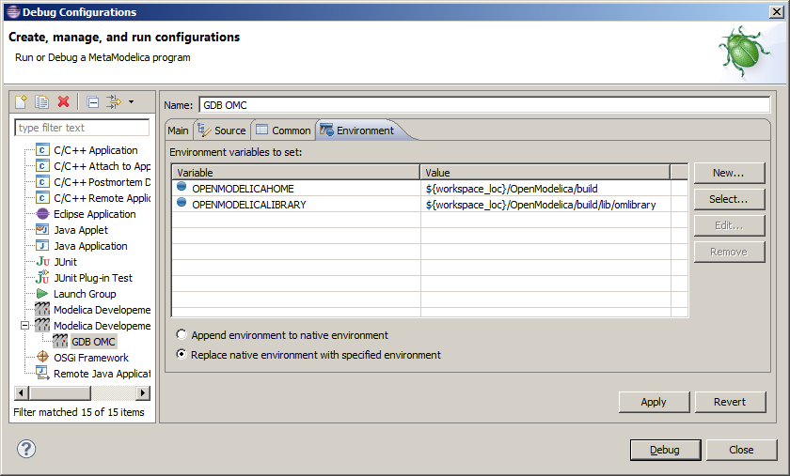
Check environment tab
Add OPENMODELICAHOME and OPENMODELICALIBRARY

Slide 30
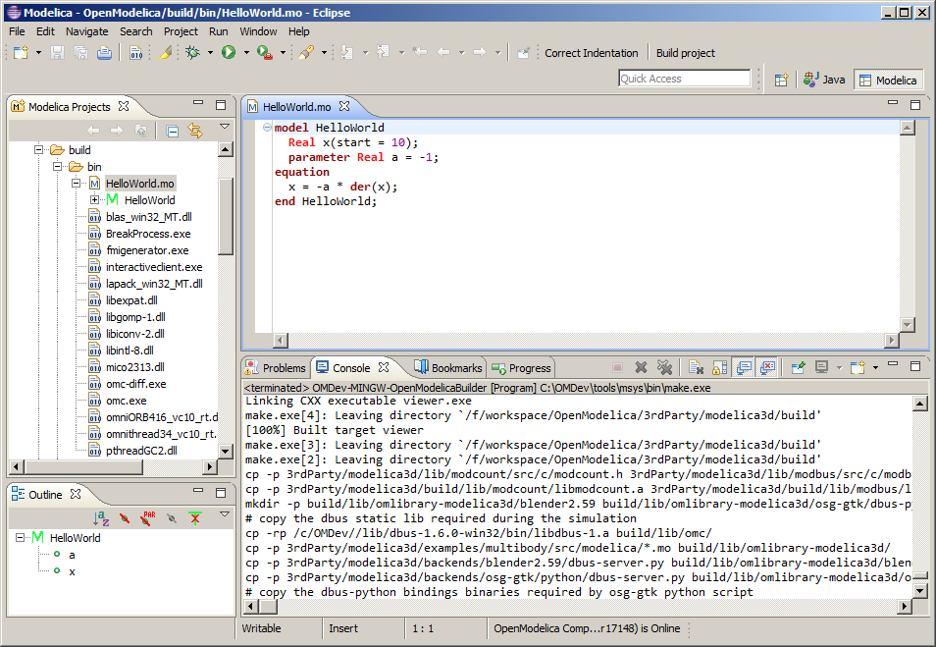
Have a test example

Slide 31
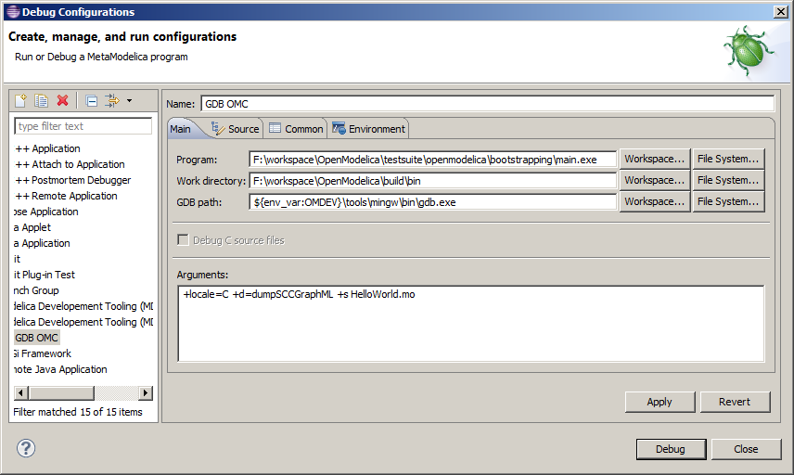
Add command line parameters

Slide 32
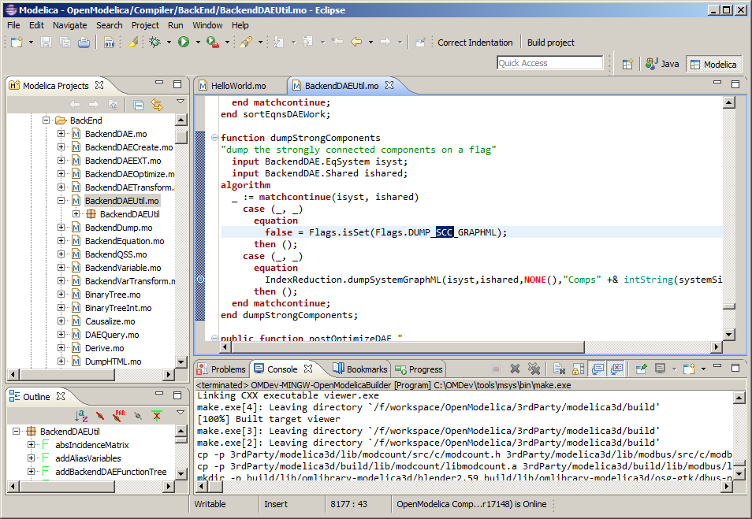
Put a breakpoint
Double click here

Slide 33
Start Debug

Slide 34
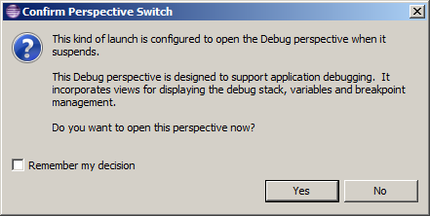
Switch to Debug perspective

Slide 35
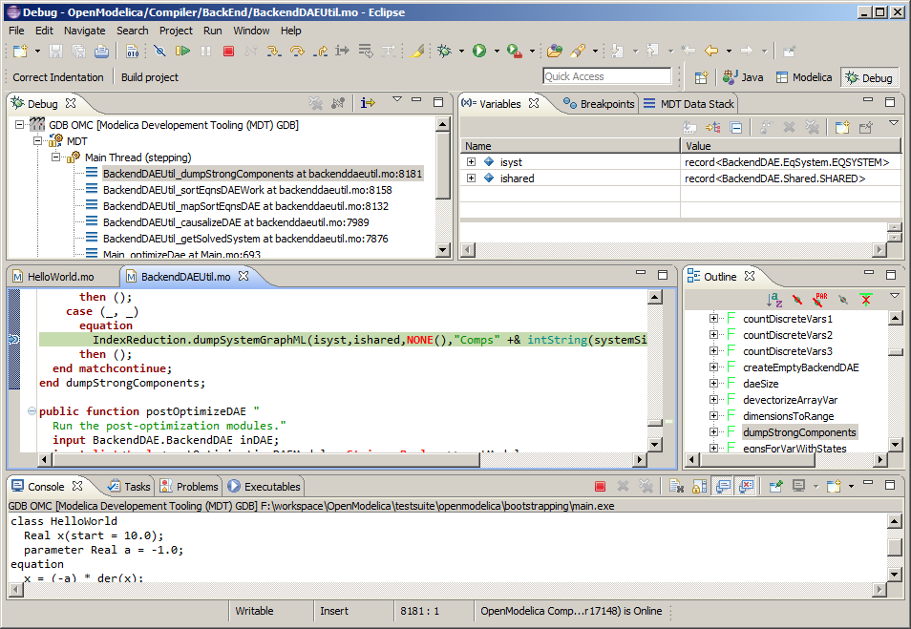
Debug perspective
stack
variables
execution point
console

Slide 36
The End
The Eclipse workspace created in this demo (only with the important parts) is here:
https://openmodelica.org/documents/
Also this document should be there
Contact Adrian.Pop@liu.se for any issues.

